Slide 1
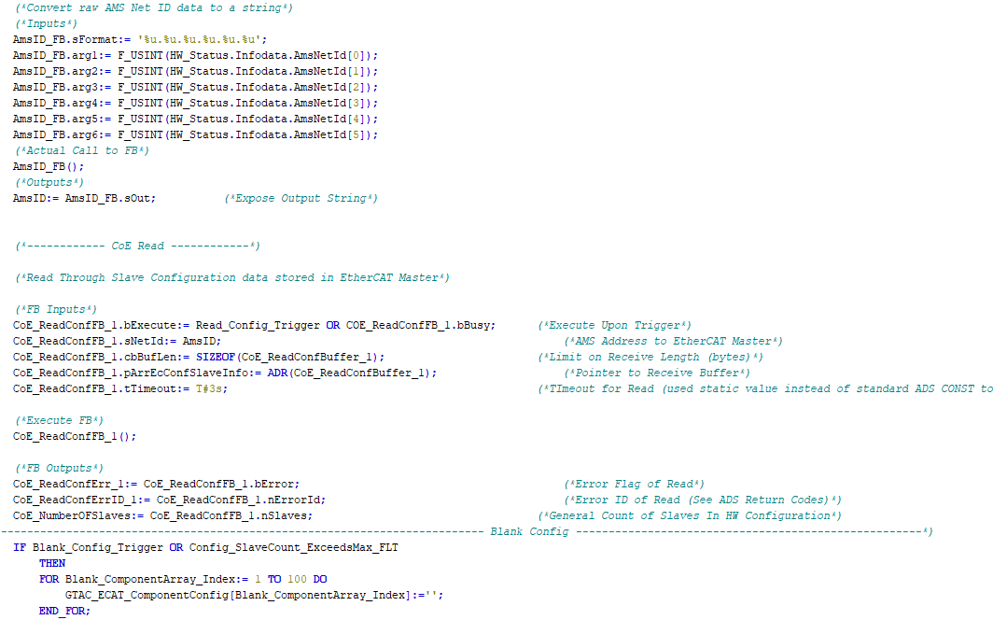

Controls Training - Intro

Slide 2

Instructor
Brent Lekx-Toniolo
Graduated in 1997/98 from Canadore College with honors diplomas in:
Electro - Mechanical Engineering Technician - Robotics (1997)
+
Computer Technology - Process Control Technologist (1998)

Slide 3







Instructor
Brent Lekx-Toniolo
Been working (off and on) with Aetna / AZ Automotive / Sodecia since August 1998
Also worked with ABB, Fletcher Group, Kuka Systems, Canadian Solar, Abbott, JAE Automation
Started and ran Toniolo R&D Inc. and OoR Tech
Worked professionally with PLCs from AB, Siemens, Beckhoff, Mitsubishi, Omron, RPC, CodeSys
Programmed professionally in Ladder, ST, FBD, STL, Assembly, C, C#, C++, Python, HTML/CSS/JS, XML
Married for 14 years, father of two girls

Slide 4

The Building Blocks - POUs, FBs, FUNs, UDTs
Why do we use these in the Framework
How to create
How to instantiate
How to edit
GTAC code element naming conventions
Training Packages

Slide 5

Framework Overview - PLC:
Some GTAC terminology
What is the PLC FW and why do we use it
Brief history of the FW
Discuss the major sections of the FW, how we use them and what they can do to help us deploy an application
Look at examples of how POUs, FBs, FUNs and UDTs are used to build the FW
Training Packages

Slide 6

Framework Overview - UI:
Some GTAC terminology
Brief overview of the UI package major sections
Discuss how PLC <-> UI exchange data
Brief overview of UI scripts
Training Packages

Slide 7


How we use CSA / ISO safety standards:
What safety standards apply to building our machines
Light curtain distance example while referencing the applicable standard(s)
Brief overview of safety programming in TC3 / our FW and how it applies to the above
Importance of this topic
Training Packages

Slide 8

WHAT WOULD YOU LIKE TO SEE?
What parts do you struggle with?
Ever wonder what a section of code does?
Training Packages

Slide 9




The new UI direction
TCHMI
Pros:
Integrated into TC3 / VS
Easier learning curve
Visual dev environment
Cons:
Locked to Beckhoff platform
Locked to Windows OS
Would require external dev enviro for our scripts (python)
Django (or other)
Pros:
Modern PC based UI / UX
Not tied to any PLC platform
OS independent
Scripting can be done in python (same environment)
Cons:
Heavily text based
Steeper learning curve
Requires workaround to integrate into TC3 / VS

Slide 10

Thanks for your time

